Slide 1
Secondary storage structure
Chapter-12

Slide 2
Device Management
In the device management task of the operating system is to manage I/O and storage devices such as printers, card readers, tapes, disk and supporting devices such as the control unit and control channel.
The major tasks of the operating system with respect to device management are:
  Track the status of all the devices
  To decide which process gets a device, for how long and where.

Slide 3
Device Management
There are three different categories of devices. On the basis of these categories, the operating system will decide which process will get which devices and for how long.
  Dedicated Device: are the devices that are assigned to one process at a time. The process releases the device once it is completed, so no pre-emption case occurs here. For example, printer
  Shared Device: are one that can be shared among different processes. These get according to the use and priority. For example, hard disk.
  Virtual Device: are a combination of both shared and dedicated devices. For example, a printer is a dedicated device and can be made sharable using spooling (queue).

Slide 4
Device Characteristics
There are majorly two types of devices under the categories mentioned above.
  I/O devices: An input device takes data as input from the user and an output device generates output. For example, Keyboard(input), printer(output).
  Storage Devices: It is a mechanism by which the computer stores the information in such a way that information may be retrieved at a later time. For example, Hard disk
  The storage devices can be of the following three different types: Serial access, Direct access.

Slide 5
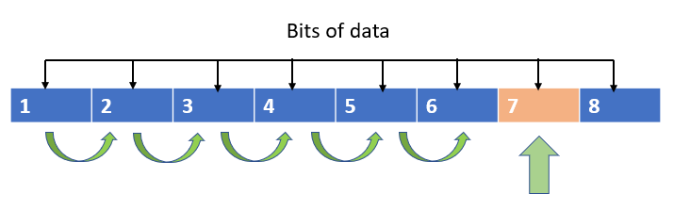
Serial Access Device
This method is also known as a sequential access method.
The data is accessed by starting from the beginning, then searched through in sequence, until the required information is found.
Very slow, example is old magnetic tapes

Slide 6
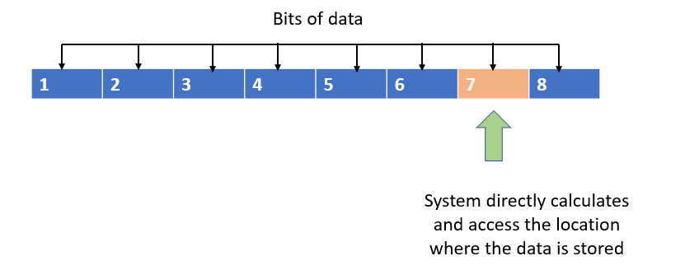
Direct Access Device
It is also known as a random access device. The system can calculate where exactly the data is stored. The location can be directly accessed.
Faster as compared to serial access device
Example is Hard disk, CD, DVD

Slide 7
Disk Scheduling
One of the major task of the operating system is to use the hardware efficiently.
For the disk drives, this can be possible if the disk has fast access time and large disk bandwidth.
  Seek time: is the time for the disk arm to move the heads to the track containing the desired sector.
  Rotational latency: is the additional time for the disk to rotate the desired sector to the disk head.
  Disk Bandwidth: is the total number of bytes transferred, divided by the total time between the first request for service and the completion of the last transfer.

Slide 8
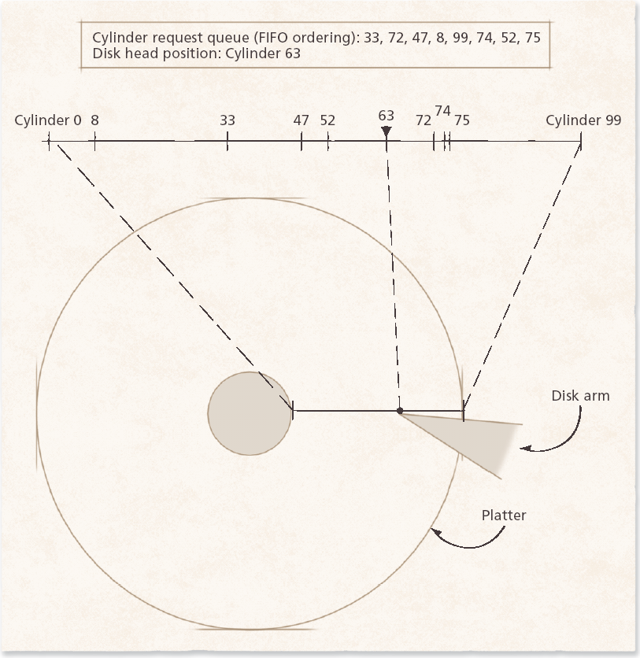

Slide 9
FCFS
The simplest form of disk scheduling.
But it does not provide the fastest service.
  Seeking to randomly distributed locations results in long waiting times
Consider, for example, a disk queue with requests for I/O to blocks on cylinders (0-199)
  98, 183, 37,122, 14, 124, 65, 67
Head starts at-53

Slide 10

FCFS
Illustration shows total head movement of 640 cylinders.

Slide 11
SSTF
Selects the request with the minimum seek time from the current head position
Service request closest to read-write head
SSTF scheduling is a form of SJF scheduling; may cause starvation of some requests

Slide 12

SSTF
Illustration shows total head movement of 236 cylinders.

Slide 13
SCAN
The disk arm starts at one end of the disk, and moves toward the other end, servicing requests until it gets to the other end of the disk, where the head movement is reversed and servicing continues.
Shortest seek time in preferred direction
SCAN algorithm Sometimes called the elevator algorithm

Slide 14

SCAN
Illustration shows total head movement of 208 cylinders.

Slide 15
LOOK
LOOK is an improvement over SCAN.
It will not service the extreme ends of the disk blocks.
It will go until the last request in the input queue

Slide 16
C-SCAN
Provides a more uniform wait time than SCAN
The head moves from one end of the disk to the other, servicing requests as it goes
  When it reaches the other end, however, it immediately returns to the beginning of the disk, without servicing any requests on the return trip

Slide 17

C-SCAN
Total head movement of 183 cylinders

Slide 18

C-LOOK
This algorithm is an improvement over C-SCAN

Slide 19
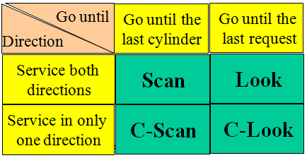
Disk Scheduling

Slide 20
Question
Which algorithm suffers from Starvation
FCFS
SSTF
SCAN

Slide 21
Question
Which of the following algorithm works like an elevator
FCFS
C-LOOK
SCAN

Slide 22
Question
Consider a disk system with 100 cylinders. The requests to access the cylinders occur in following sequence-
4, 34, 10, 7, 19, 73, 2, 15, 6, 20
Assuming that the head is currently at cylinder 50, what is the time taken to satisfy all requests using disk scheduling algorithms

